Slide 1
Java Memory Model
Presented by: Bello Muhammad

Slide 2


Content
Java Virtual Machine
Hotspot Architecture
Class Loader Subsystem
Runtime Data Areas
The Heap
Java Threads or Thread Stack
Execution Engine
JIT Compiler
Garbage Collectors
Conclusion

Slide 3

Java Virtual Machine
The Java Virtual Machine (JVM) is an abstract computing machine. The JVM is a program that looks like a machine to the programs written to execute in it.
The Java virtual machine knows nothing of the Java programming language, only of a particular binary format, the class file format. A class file contains Java virtual machine instructions (or bytecodes) and a symbol table, as well as other ancillary information.

Slide 4
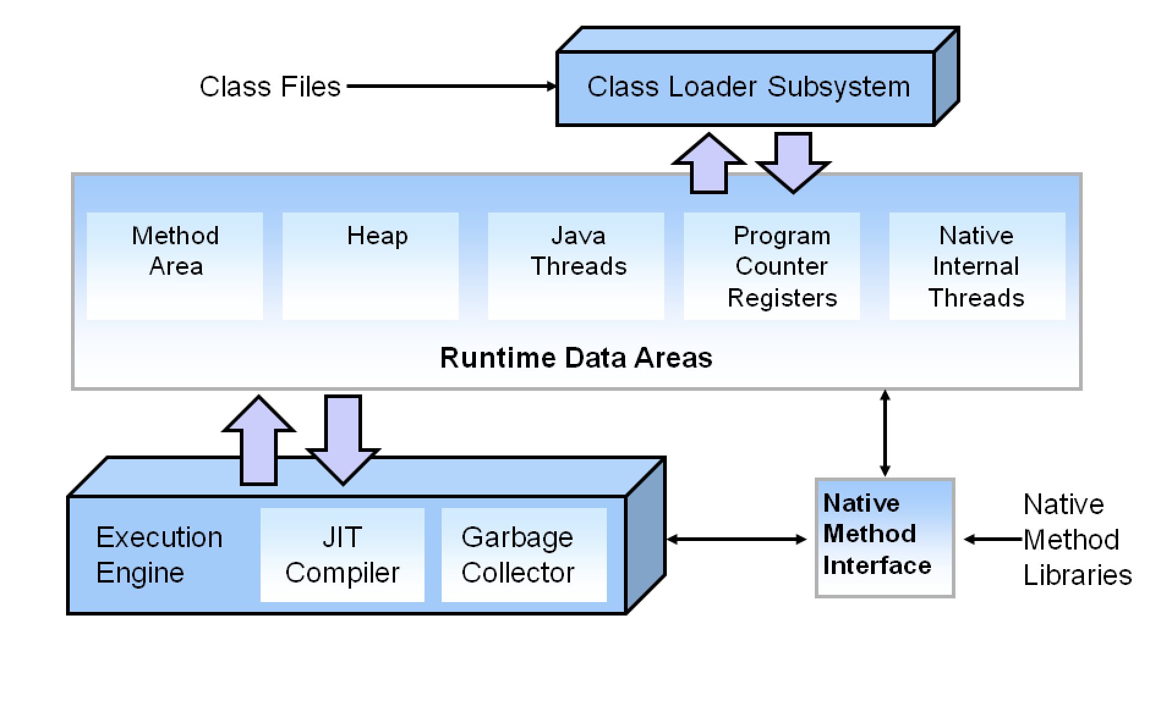
Hotspot Architecture

Slide 5
Class Loader Subsystem
The classloader subsystem is an essential core of the Java Virtual machine and is used for loading/reading the .class. It loads, links and initializes the class when it refers to a class for the first time. Class loader subsystem is responsible for following 3 activities.
Loading: The Class loader reads the .class file, generate the corresponding binary data and save it in method area.
Linking: Performs verification, preparation, and (optionally) resolution.
Initialization: In this phase, all static variables are assigned with their values defined in the code and static block(if any). This is executed from top to bottom in a class and from parent to child in class hierarchy.

Slide 6
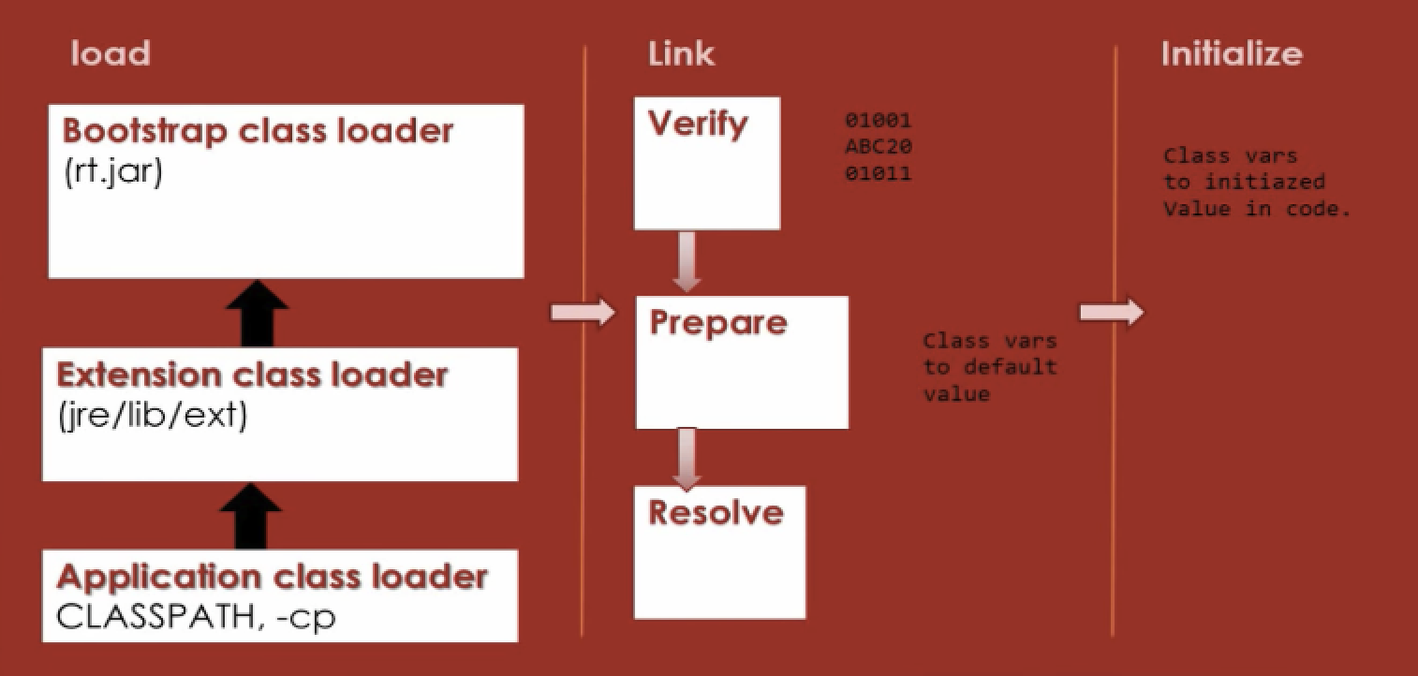
Class Loader Subsystem Cont.

Slide 7
Runtime Data Area
The runtime data area also known as memory management area is divided into five major components.
Method Area
Heap
Java Thread (Stack Area)
Program Counter Register (PC Register)
Native Method Area (Native Method Stack)

Slide 8
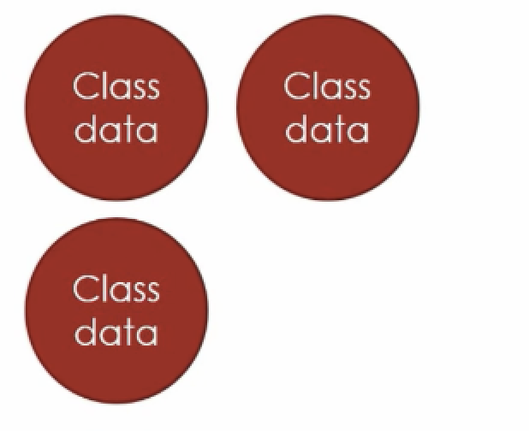
Runtime Data Area Cont.
Method Area:
The method area is the one responsible for holding all class level information like class name, immediate parent class name, methods and variables information etc. are stored, including static variables. There is only one method area per JVM, and it is a shared resource.

Slide 9
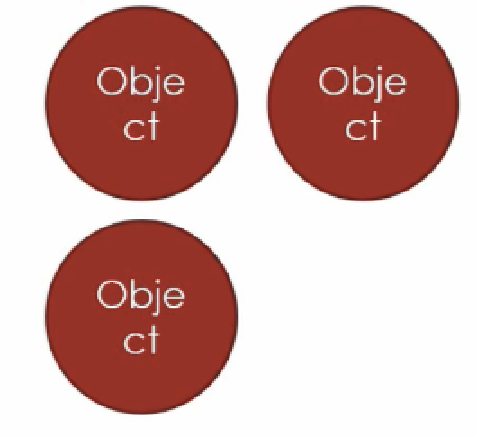
Runtime Data Area Cont.
Heap:
This component is a part of JVM memory where all the objects and its corresponding instance variables and arrays are stored. This memory area is created on the JVM start-up and there is only one heap area shared across multiple threads as the data stored in this area is not thread-safe.

Slide 10
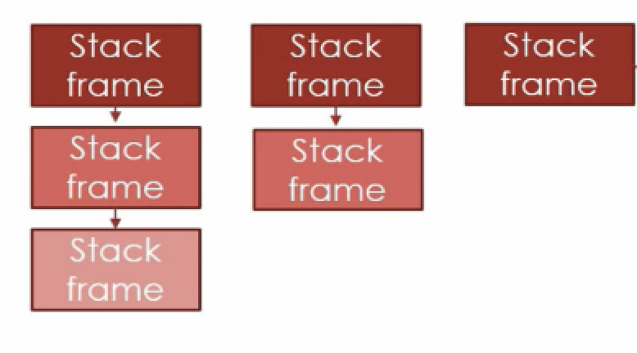
Runtime Data Area Cont.
Java Threads (Stack Threads):
For every thread, JVM create one run-time stack area which is stored here. Every block of this stack is called activation record/stack frame which store methods calls. All local variables of that method are stored in their corresponding frame.The stack area is thread safe since it is not a shared resource. After a thread terminate, it’s run-time stack will be destroyed by JVM.

Slide 11
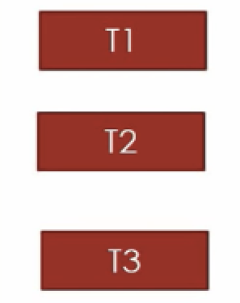
Runtime Data Area Cont.
Program Counter Register (PC Register):
This component holds the address of the JVM instruction which is currently executing. Each thread in Java has its own PC register to hold the address of the currently executing instruction.

Slide 12
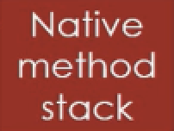
Runtime Data Area Cont.
Native Internal Thread (Native Method Stack):
This component is written in a different language and holds the native method information. Every thread in Java has a separate native method stack. The following exceptional condition is associated with this area.

Slide 13
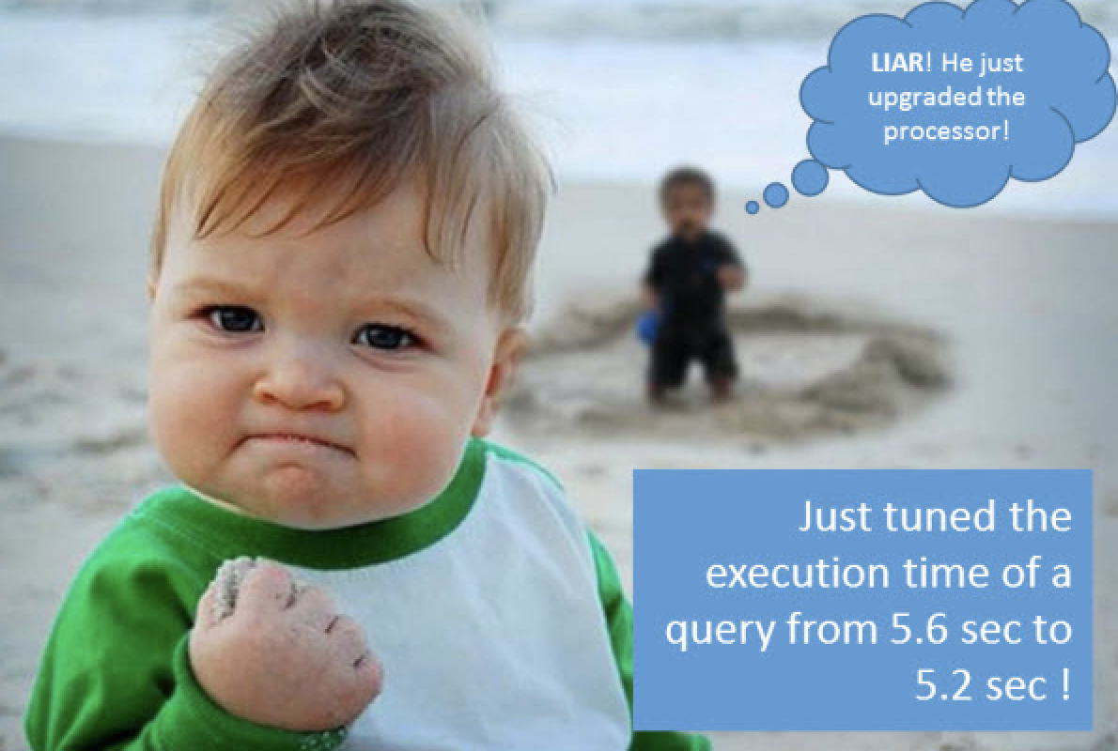
Execution Engine

Slide 14
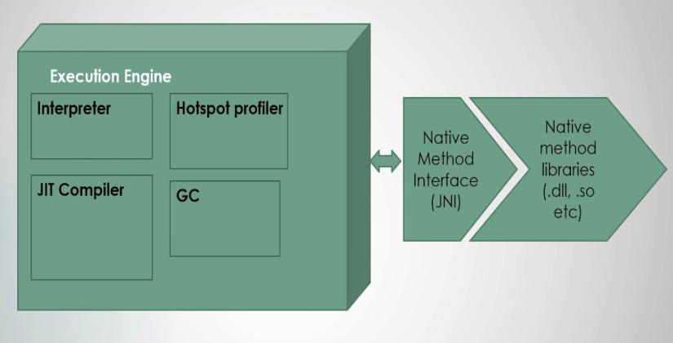
Execution Engine
When everything is alright, the execution engine is then going to execute the generated bytecode. The java code will be executed by both interpreter and JIT compiler simultaneously which will reduce the execution time and then by providing high performance.

Slide 15

Execution Engine Cont.
Hotspot Profiler:
Interpreting bytecodes in the Java virtual machine (JVM) is slow.

Slide 16
Execution Engine Cont.
Hotspot Profiler:
Interpreting bytecodes in the Java virtual machine (JVM) is still exceedingly slow.
The HotSpot profiler looks for "hot spots" in the code, i.e. methods that the JVM spends a significant amount of time running, and then compiles those methods into native generated code.
Let’s say there are some instructions that are been executed again and again, the interpreter will not interpret the instructions again and again. The JIT Compiler will compile those instructions and keeps the target machine code ready for execution.
These set of instructions are like hotspots which the Hotspot Profiler will keep an eye on and then act accordingly to optimize the performance of Java Virtual Machine.

Slide 17

Execution Engine Cont.
Garbage Collector:

Slide 18
Milestones
October 2014
October 2015
August 2015
November 2015
Translate web pages with Chrome extension
Translate text within an app
2014 |  |  |  | 2015
Translate conversations through your Android watch
Translate written text from English or German to Arabic with the click of a camera

Slide 19
What people are saying
With this app, I’m confident to plan a trip to rural Vietnam
Wendy Writer, CA
Visual translation feels like magic
Ronny Reader, NYC
Translate has officially inspired me to learn French
Abby Author, NYC
Quotes for illustration purposes only

Slide 20


Know a 2nd language? Make Google Translate even better by joining the community.
Tip
Inspire your audience to act on the information they just learned.
Depending on your idea, this can be anything from downloading an app to joining an organization.

